Slide 1

CivicPulse
Smart Governance Management Platform for Administrative Operations with Citizen Service Assistance
Internship Project Presentation
Department of Computer Science

Slide 2



The Problem
Civic complaint redressal in most cities is slow, opaque, and disconnected
No Central Platform
No Status Visibility
Citizens rely on phone calls, in-person visits, or scattered portals for different departments.
Once filed, complaints vanish into a black box with no tracking or expected timeline.
Manual Routing
No Accountability Data
Staff manually forward complaints to the correct department, causing delays and errors.
Governments lack analytics to identify recurring issues or measure department performance.

Slide 3





Project Objectives
What CivicPulse sets out to achieve
Unified Citizen Access
Automated Routing
SLA-Based Tracking
Single portal for citizens to file, track, and rate complaints.
Route complaints to the right government body by category & location.
Set resolution timelines and flag overdue complaints automatically.
Admin Oversight
Data-Driven Insight
Secure Access Control
Give department admins tools to review, act on, and close complaints.
Dashboards revealing hotspots, response times, and satisfaction.
Role-based login separating citizen and government access.

Slide 4
Existing vs. Proposed System
Existing System
CivicPulse (Proposed)
Complaints filed via phone calls, paper forms, or in-person visits
Online portal — file a complaint in minutes, anytime
Manual forwarding between departments — slow & error-prone
Automated category & location-based routing to the right body
No tracking ID or status updates for citizens
Real-time status tracking with a unique complaint ID
No unified record across departments
Centralized database across all government departments
No performance data on resolution speed
Analytics dashboard for accountability & SLA compliance

Slide 5








System Architecture
Layered architecture connecting citizens, platform services, and government bodies
PRESENTATION LAYER
Citizen Web
Admin Portal
APPLICATION LAYER
Auth & Role Management
Complaint Service API
Notification Service
ROUTING ENGINE
Category & Location-Based Auto-Routing
SLA Monitor
DEPARTMENT MODULES
Water
Electricity
Roads
Sanitation
Others
DATA LAYER
Centralized Database
Cloud Storage

Slide 6


Unique Features
emphasizes what makes your project different
*1. Auto-Forward if No Action If an officer doesn't respond within 2 days, the complaint automatically escalates to their senior. Keeps complaints from getting silently ignored.*
2. Reopen a "Fixed" Complaint Citizens can reopen a resolved complaint within 5 days if the issue reoccurs, instead of filing a new one. Prevents repeat problems from being treated as fresh, unrelated tickets.
3. Group Officer Actions*Officers can select multiple similar complaints in the same area and mark them all resolved in one action. Saves time on repetitive, one-by-one updates.
User Module
Admin Module
1. Auto-Forward if No Action : If an officer doesn't respond within 2 days, the complaint automatically escalates to their senior. Keeps complaints from getting silently ignored.
2. Reopen a "Fixed" Complaint : Citizens can reopen a resolved complaint within 5 days if the issue reoccurs, instead of filing a new one. Prevents repeat problems from being treated as fresh, unrelated tickets.
3. Group Officer Actions : Officers can select multiple similar complaints in the same area and mark them all resolved in one action. Saves time on repetitive, one-by-one updates.
Register / login with secure credentials
Department-wise login (Water, Roads, Electricity, etc.)
File complaints with category, location & photo evidence
View & filter complaints assigned to their department
Track real-time status with a unique complaint ID
Update status: Assigned → In Progress → Resolved
Receive SMS / email notifications on updates
Escalate overdue complaints breaching SLA
Rate resolution & give feedback
Access analytics on department performance
View complaint history
Super-admin view across all departments

Slide 7
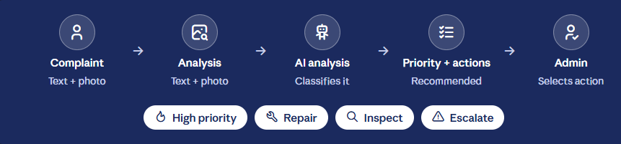
Unique Features
emphasizes what makes your project different
*1. Auto-Forward if No Action If an officer doesn't respond within 2 days, the complaint automatically escalates to their senior. Keeps complaints from getting silently ignored.*
2. Reopen a "Fixed" Complaint Citizens can reopen a resolved complaint within 5 days if the issue reoccurs, instead of filing a new one. Prevents repeat problems from being treated as fresh, unrelated tickets.
3. Group Officer Actions*Officers can select multiple similar complaints in the same area and mark them all resolved in one action. Saves time on repetitive, one-by-one updates.
User Module
Admin Module
AI-Powered Complaint Analysis
Register / login with secure credentials
Department-wise login (Water, Roads, Electricity, etc.)
File complaints with category, location & photo evidence
View & filter complaints assigned to their department
Track real-time status with a unique complaint ID
Update status: Assigned → In Progress → Resolved
Receive SMS / email notifications on updates
Escalate overdue complaints breaching SLA
Rate resolution & give feedback
Access analytics on department performance
View complaint history
Super-admin view across all departments

Slide 8
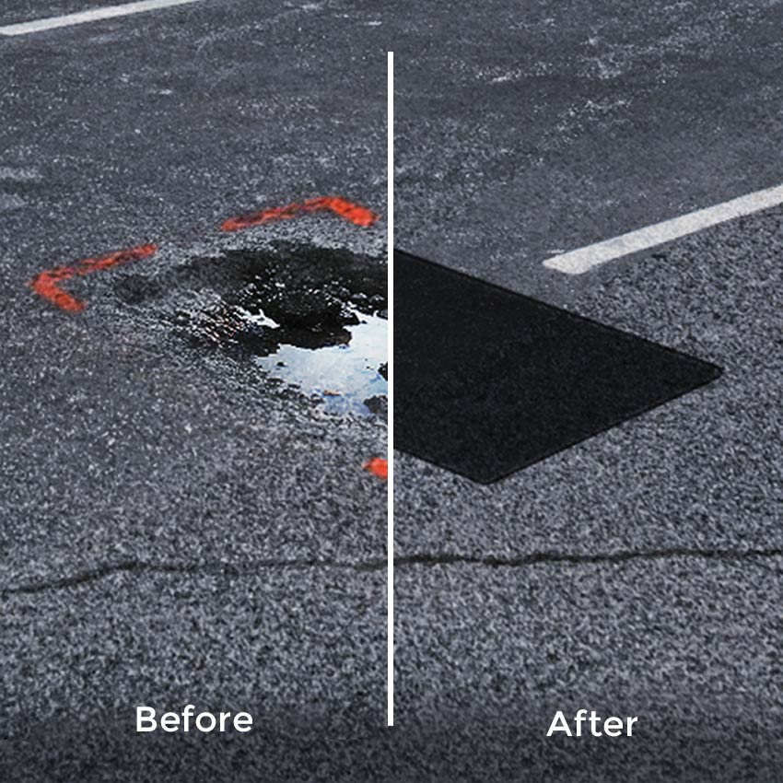
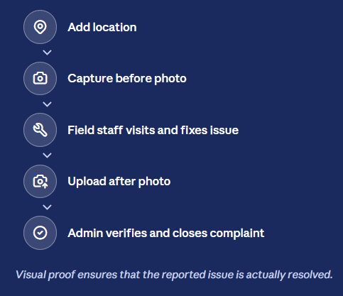
Unique Features
emphasizes what makes your project different
*1. Auto-Forward if No Action If an officer doesn't respond within 2 days, the complaint automatically escalates to their senior. Keeps complaints from getting silently ignored.*
2. Reopen a "Fixed" Complaint Citizens can reopen a resolved complaint within 5 days if the issue reoccurs, instead of filing a new one. Prevents repeat problems from being treated as fresh, unrelated tickets.
3. Group Officer Actions*Officers can select multiple similar complaints in the same area and mark them all resolved in one action. Saves time on repetitive, one-by-one updates.
Field Verification & Resolution Proof
User Module
Admin Module
Register / login with secure credentials
Department-wise login (Water, Roads, Electricity, etc.)
File complaints with category, location & photo evidence
View & filter complaints assigned to their department
Track real-time status with a unique complaint ID
Update status: Assigned → In Progress → Resolved
Receive SMS / email notifications on updates
Escalate overdue complaints breaching SLA
Rate resolution & give feedback
Access analytics on department performance
View complaint history
Super-admin view across all departments

Slide 9
Core Modules
Two focused experiences on one platform
User Module
Admin Module
Register / login with secure credentials
Department-wise login (Water, Roads, Electricity, etc.)
File complaints with category, location & photo evidence
View & filter complaints assigned to their department
Track real-time status with a unique complaint ID
Update status: Assigned → In Progress → Resolved
Receive SMS / email notifications on updates
Escalate overdue complaints breaching SLA
Rate resolution & give feedback
Access analytics on department performance
View complaint history
Super-admin view across all departments

Slide 10


Complaint Lifecycle
From submission to resolution — fully tracked at every step
1
2
3
4
5
6
Submit
Auto-Route
Review
Action
Resolve
Feedback
Citizen files complaint with category & location
System assigns to the correct department
Department admin reviews & assigns priority
Field team resolves the reported issue
Status marked resolved with proof/update
Citizen rates the resolution & closes ticket
Every complaint carries an SLA timer — overdue tickets are auto-escalated to senior officials.

Slide 11

Technology Stack
A modern, scalable stack for a citizen-facing government platform
FRONTEND
BACKEND
DATABASE
SECURITY
React.js
Node.js
MySQL / MongoDB
JWT Authentication
HTML5 / CSS3
Express.js
Cloud Storage
Role-Based Access
Responsive UI
REST APIs
Automated Backups
Data Encryption

Slide 12
Database Design
Core entities that power CivicPulse
Users
Complaints
Departments
user_id, name, email, phone, password_hash, address
complaint_id, user_id, category, description, location, status, sla_deadline
dept_id, name, category, contact_info
Admins
Status Logs
Feedback
admin_id, dept_id, name, role, email
log_id, complaint_id, status, updated_by, timestamp
feedback_id, complaint_id, rating, comments

Slide 13


Key Features
What makes CivicPulse stand out
Location-Based Routing
Real-Time Notifications
SLA & Escalation
Complaints auto-assigned to the right ward / department.
SMS & email alerts on every status change.
Automatic escalation when deadlines are missed.
Analytics Dashboard
Citizen Feedback
Secure Role-Based Access
Visual insights into complaint volume & resolution time.
Star ratings & comments after resolution.
Separate, protected logins for citizens & officials.

Slide 14
Benefits & Future Scope
Benefits
Future Scope
Faster complaint resolution through automated routing
AI-based auto-categorization & priority prediction
Greater transparency & trust between citizens and government
GIS heat-maps of complaint density by area
Reduced administrative overhead for departments
Chatbot for instant citizen query resolution
Data-backed decisions using analytics dashboards
Integration with municipal payment & billing systems
Improved citizen satisfaction and civic engagement
Multi-language support for wider accessibility

Slide 15
CivicPulse bridges the gap between citizens and government —
making complaint resolution faster, transparent, and accountable.
Thank You
Questions & Discussion

